Slide 1


Meet Your Blog:
The hardest-working content you’ll write

Slide 2




Two Huge Reasons why Blogging’s so Brilliant:
Your SEO’s best friend
Your 24/7 networker

Slide 3
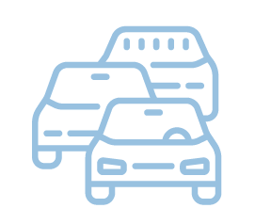


Your SEO’s best friend
Getting Found on Google
SEO – Google’s tick list
More Searchable Keywords
Is the site updated regularly?
Does it get regular traffic?
Do other sites link to it?
Is it a credible source of information?
Every post is a new page (and new keyphrase term) on your website
Reusable content
Posts, emails, lead magnets, guides…

Slide 4


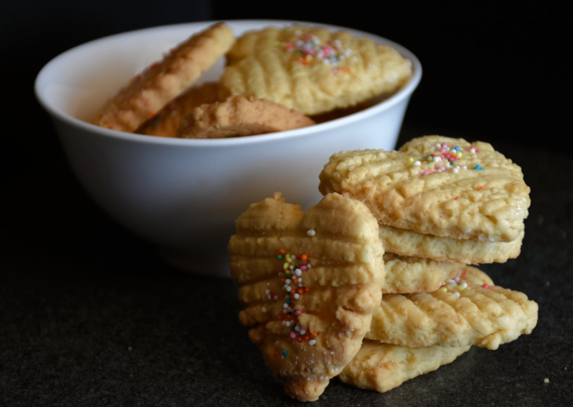
Your 24/7 Networker
Credibility
Your background
Your expertise
Brand Personality
Express your brand values
Attract your best customers
Connection and Social Proof
Reasons to work with you
A little bit extra you’re giving away

Slide 5

What to blog about…
What you enjoy writing about
What your customers want to read
How your customers search Google and how you want to be found
…it’s all about balance

Slide 6
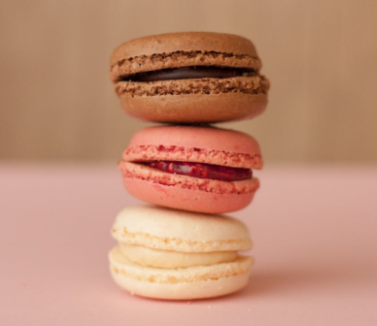
Consistency is Key
Decide on your ‘Three Pillars’…here are mine:
Writing and Words (products, expertise, passion)
Family life (my background, my Why, personality, values)
Other businesses and Milton Keynes (promotes my writing, increases shares, helps others)
How much? 500 words min
How often? Regularity over frequency

Slide 7

Breaking it Down – Blog Post Types
Products and Services
Lists and Tips
Opinions and Explainers
About You
New lines
Top tips for…
Your market
Your history
How to use…
Step by step…
Legislation
Your ‘why’
Case Studies
Top 10 recommended…
Current affairs
Your week

Slide 8
Getting it Done
Plan It
Publish It
Share It
Plan the year – start with seasonal
Ideally: your own website
Social media
Theme your months – build into a plan
Publishing platforms like Substack
Mailing list
Blog / SM / emails / networking
Other platforms: LinkedIn, blog-only sites
Networking
Diarise it

Slide 9
Now Your Blog Really Gets To Work…
✓
New reason to share your site each month
✓
A whole library of reasons for people to buy from you
✓
Stacks of content you can use and reuse
✓
Brownie points with Google that grow exponentially

Slide 10


Success Stories

Slide 11

Any Questions…
What’s Next?
The First Task
Tasks 2 & 3
Support in the Facebook Group
Wrapping up

Slide 12
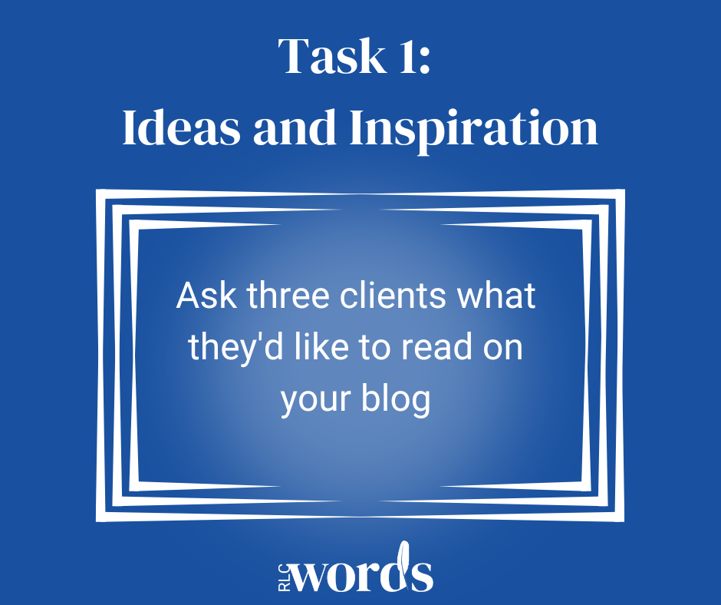
Your First Task…

